Slide 1
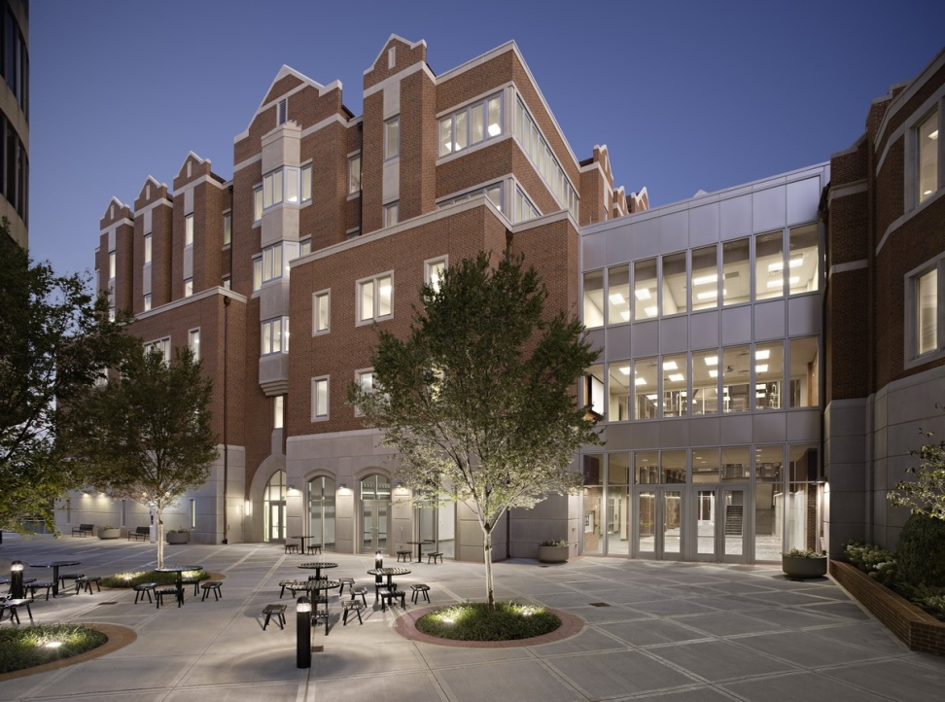


R Overview
Pointers and ShortCuts
© T. Allen Pannell, Jr.
PROVEN. RESULTS. FASTER.

Slide 2
Session Objectives
To introduce R and R Studio
To describe basic R Studio elements
To define basic R structures
To define basic R functions

Slide 3
What is R?
https://en.wikipedia.org/wiki/R_(programming_language)#:~:text=R%20is%20a%20programming%20language%20and%20free%20software,miners%20for%20developing%20statistical%20software%20and%20data%20analysis.
R is a open source (free) programming language
R is a collection of functions that operate on
Objects, which can be raw data or other information,
And packages are a collection of similar functions

Slide 4

Some of my Screenshots are from Brendan - Thanks

Slide 5
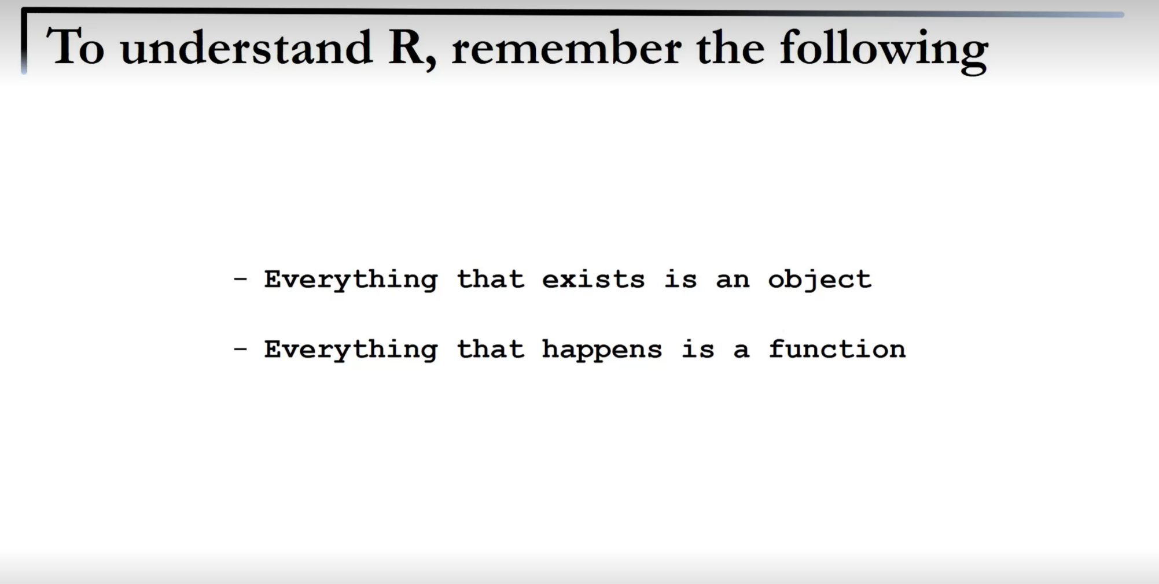

The Bottom Line

Slide 6
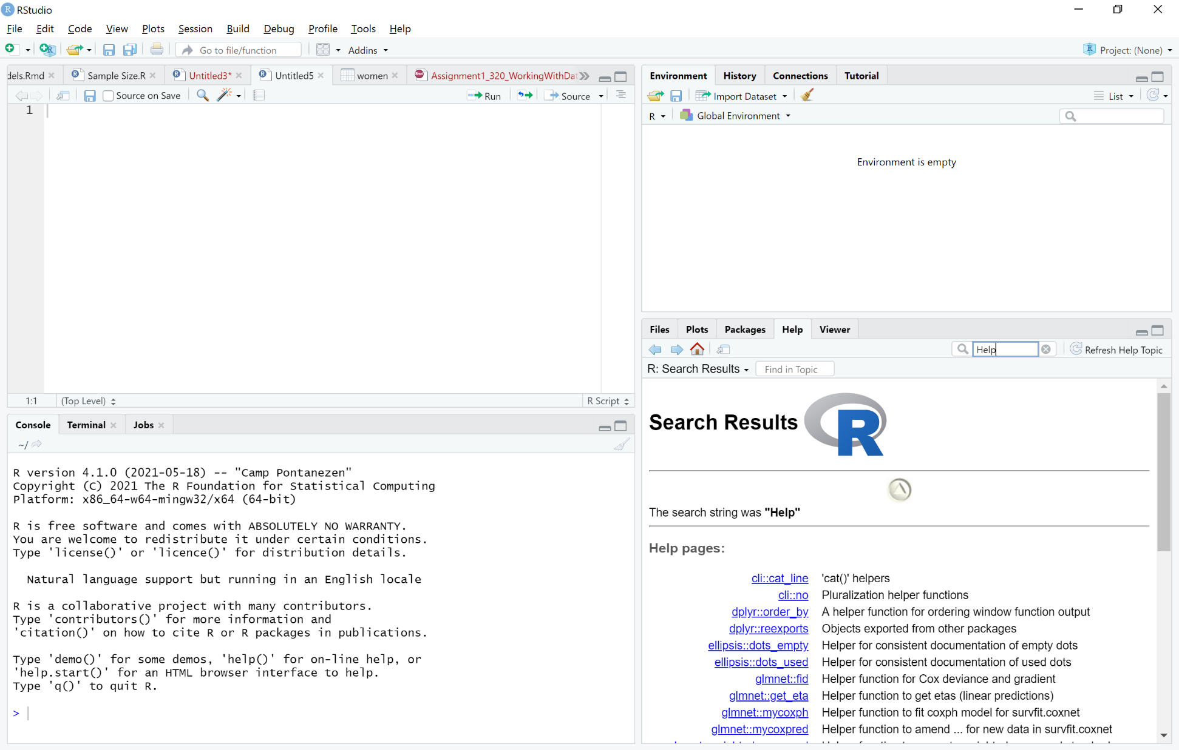
R Studio
4 “Panes”
“Environment” – Object List
Code Editor - Write Code
Plots and Help
R Console – Runs Code
Shows Results

Slide 7
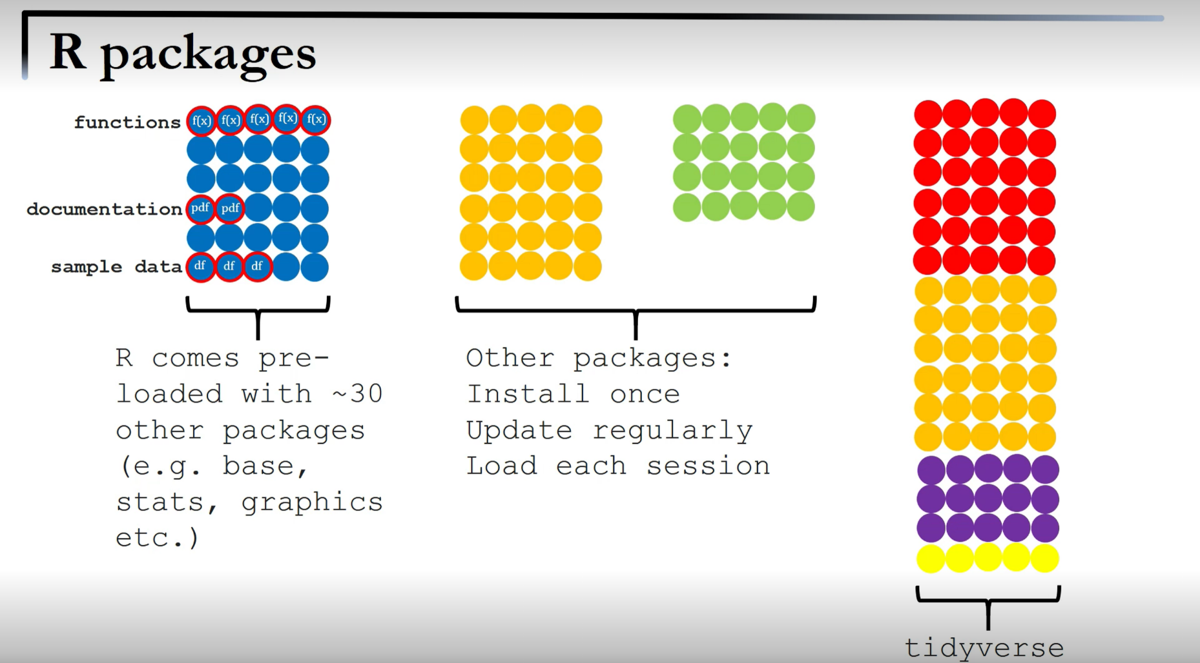
To Use R, We Need Packages

Slide 8
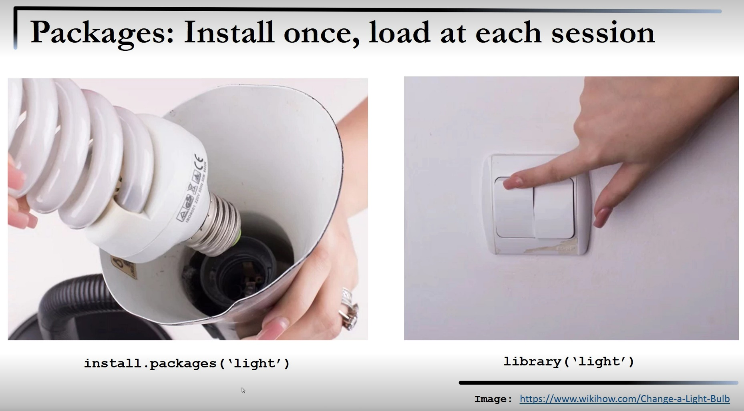
Packages

Slide 9
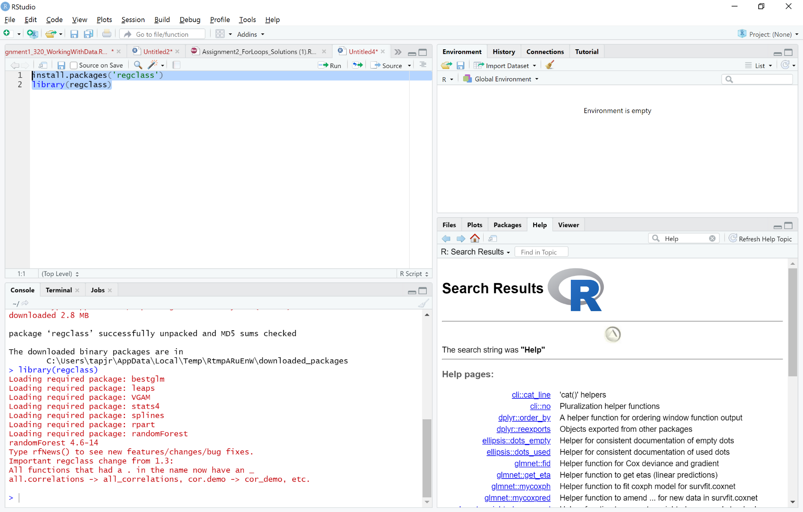
Here is one we will use

Slide 10
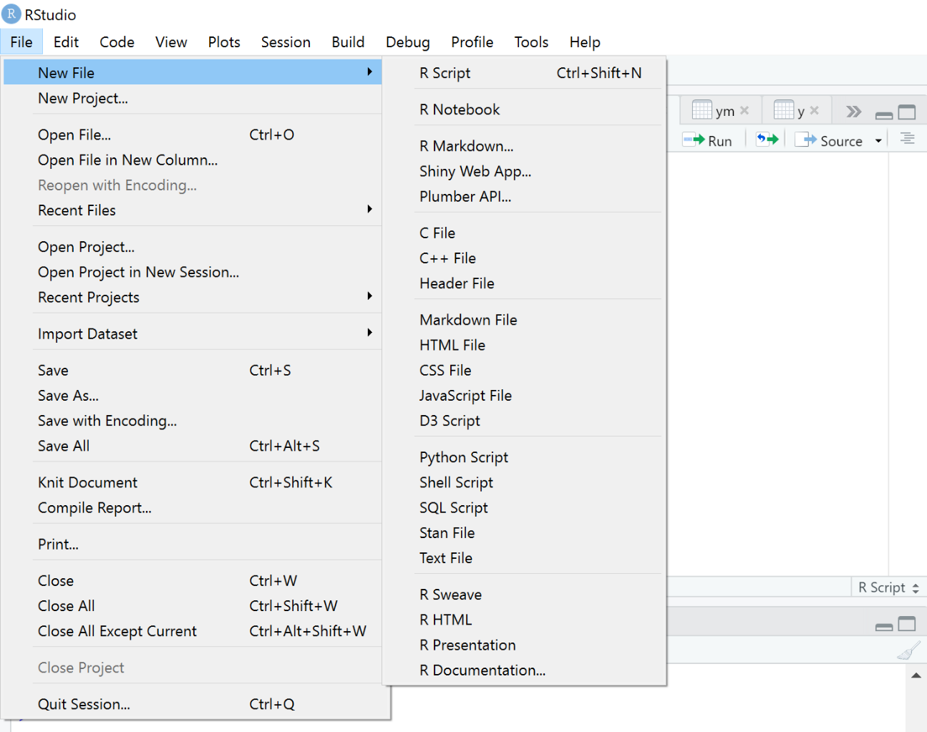
Saving Your Work
R Script
R Markdown

Slide 11
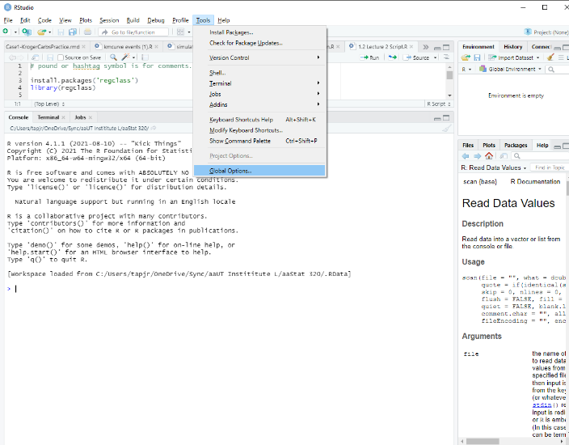
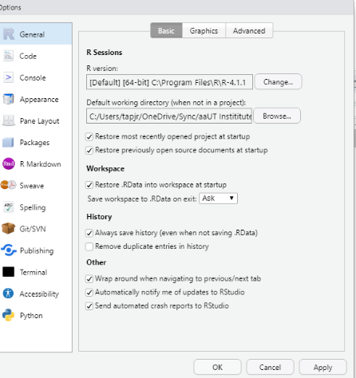
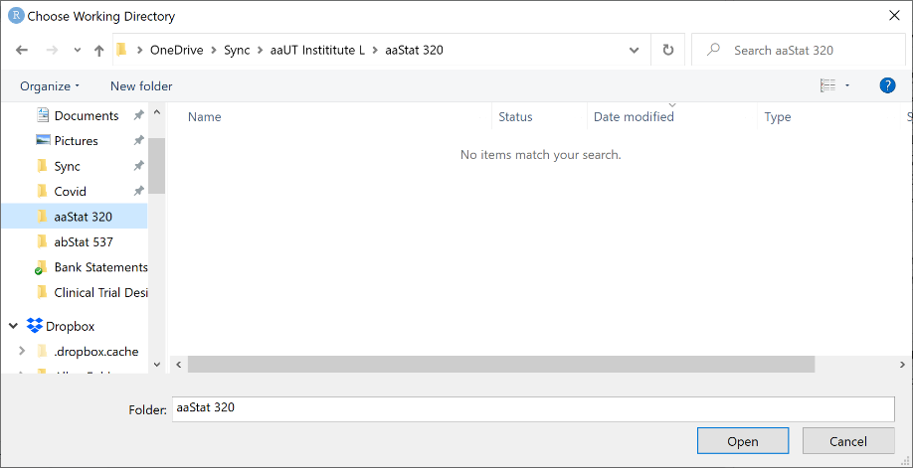
Working Directory******
Watch Video

Slide 12
Working Directory Extra

Slide 13
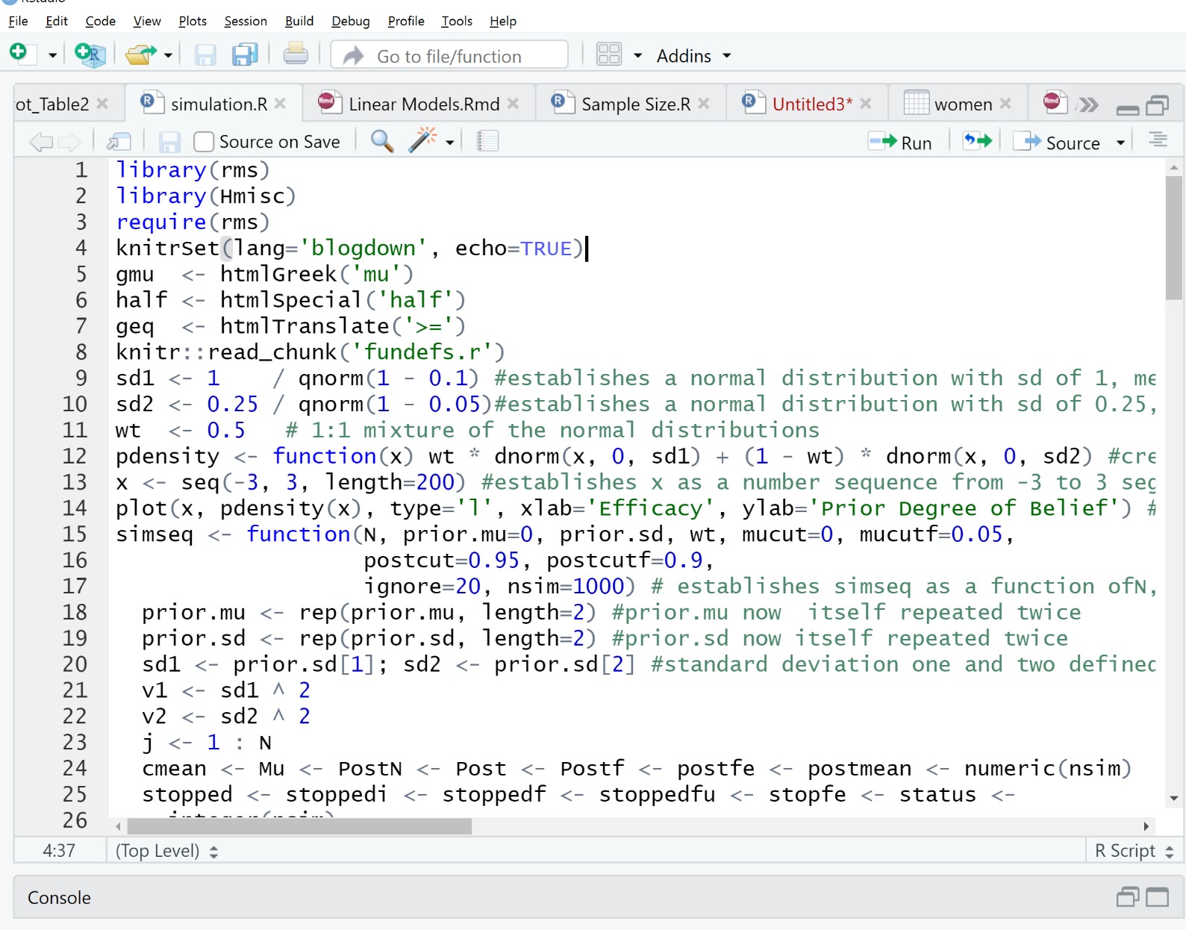
R Script – Like a Word doc – Only has code
Has blue icon – Tabs for various files
Name is red if not saved

Slide 14
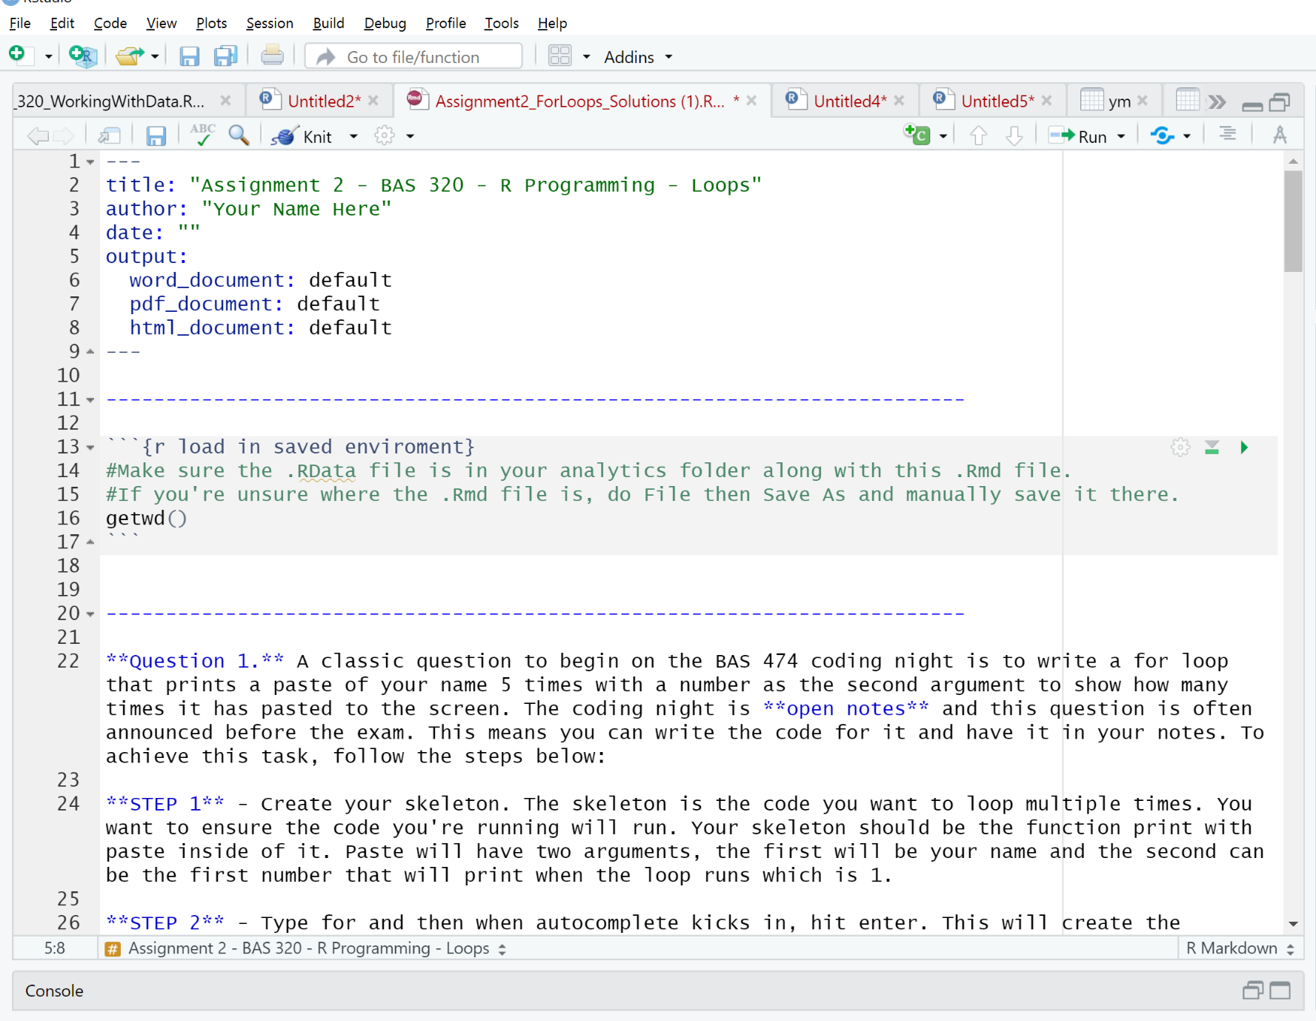
R Markdown – Like a Word doc – Has code and words (for reporting) – Very Cool
Has Red icon
Auto generated Information
Code “Chunk”
Report wording

Slide 15
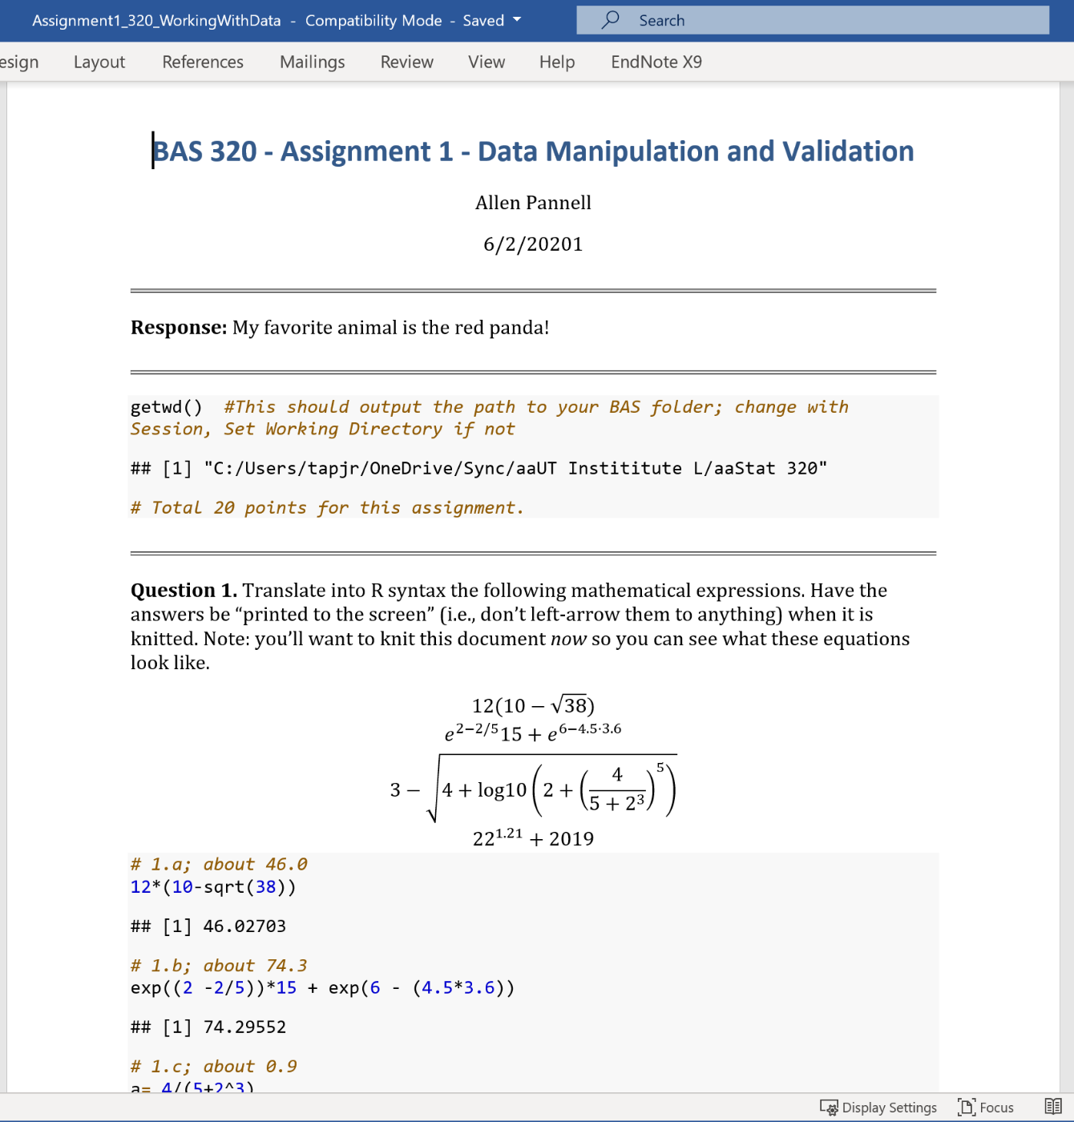
After “Knitting” a Markdown

Slide 16
What is a Function?
Performs a task or tasks
Has a name (just about anything), is case sensitive and has ()
Arguments go in the ()
Some are required
Some are preset and optional
Order doesn’t matter for the optional if named
Functions “operate” on objects
Example – mean(x) gives the mean (average) of the object x
Let’s see

Slide 17
What is an Object
A collection of information
Simple = a vector (string/column of data)
Then a matrix or data.frame
Like a spreadsheet
Complex = a table of facts and output and descriptions (List)
Let’s see

Slide 18
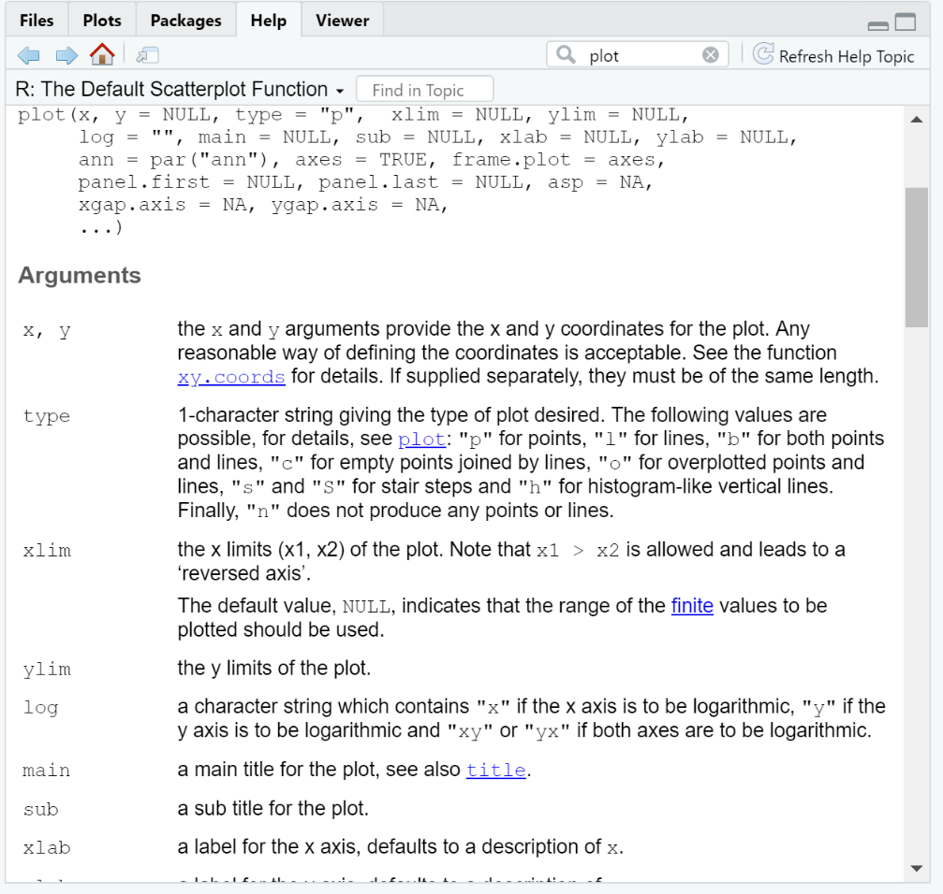
Let’s Argue
How do Arguments work?
Function(object, other arguments)

Slide 19
Key Concepts to Document Today
Ctrl enter = Run
Highlight code to run more that one line
c(a,b,c,…….) makes a vector
<- is like =. Assigns RHS to LHS
Naming objects
Letters and numbers and . or _
lowercase for vectors
UPPERCASE for data.frames
# for putting comments in code
Autocomplete needs 3 letters

Slide 20
Memorize or Note this
Getting data into R
Don’t use the Import functions. None of us do and we don’t know much about them
Do use:
read.csv(“file name.csv and maybe path”) – for .csv files in your class folder or elsewhere with path
data(“file name in a package”) – for files that come with packages we load
load(“File name of a .rdata”) – for rdata files we have in a folder.
We don’t export data in this class, but we might play with that later.

Slide 21
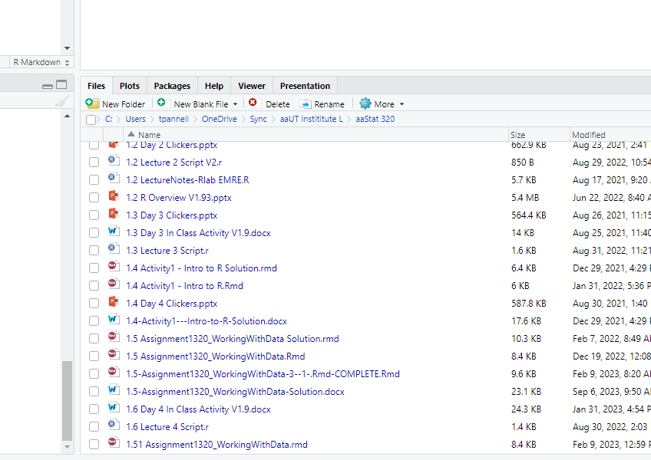
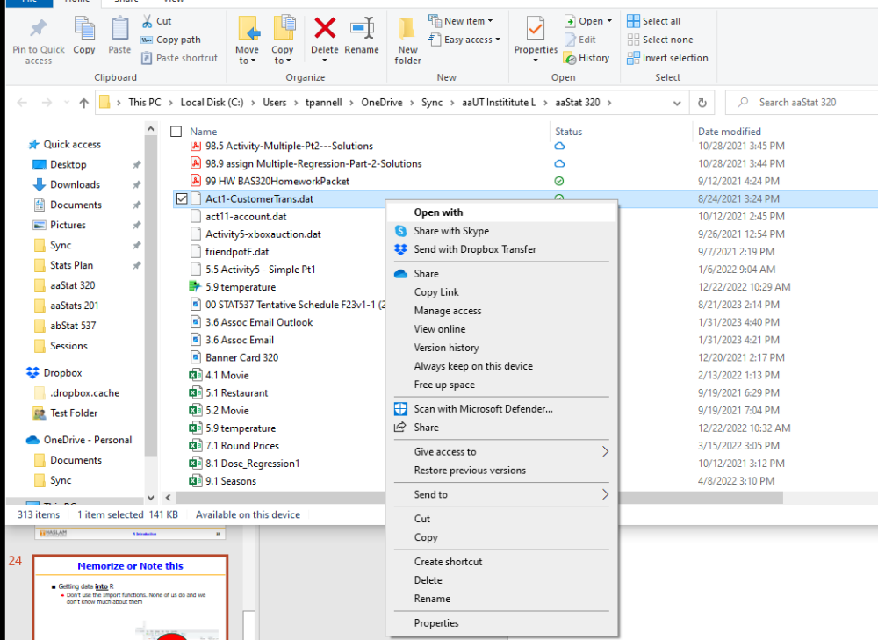

Memorize or Note this
Getting data into R
Don’t use the Import functions. None of us do and we don’t know much about them

Slide 22
If you want to Export Data
Getting data out of R
Don’t use the Export functions.
Do use:
write.csv(object_name, “file name.csv and maybe path”) – for .csv files in your class folder or elsewhere with path
data- no export
save(object_name(,s), file = “file name of a .rdata”) – for creating rdata files to load back in. Saves whatever is in the Global Environment

Slide 23
The End…… of the beginning
?????????

Slide 24
library(qcc
ls(pos = "package:qcc") # names of all the objects in an environment (package)
Bhold = qcc::qcc.options() # :: not sure literal meaning, but accesses the objects in a list
Bhold$exp.R.unscaled

Slide 25
data(pistonrings)
attach(pistonrings) # Allows for using variable name w/o $ or data=

Slide 26
